Slide 1
Final Dissertation Presentation Dissertation FT-18 M. Tech. -RTES

Slide 2
Student Details
Student Name: PRASHAANTH R M
Reg. No: 18ETCS037001
Faculty Of Engineering And Technology
Department : Computer Science And Engineering
Programme : RTES
Batch : FT 2018

Slide 3
Title of the Dissertation
Performance Analysis of Concurrent Fire detection and Alarm system
Supervisor
Mrs. Jishmi Jos Choondal
Place of Work: Bangalore

Slide 4
Outline
Title
Introduction
Summary of Literature Review
Aim and Objectives
Presentation of the Dissertation Work
Objective wise
Results and Discussions
Conclusions and Outcomes
Suggestion for future work
References

Slide 5
Title
Performance Analysis of a Concurrent Fire Detection and Alarm system

Slide 6
Introduction
Embedded system has a wide range of study. Every day we come across hundreds to thousands Embedded system. The current generation that is followed in Embedded systems is being filled with different real-time applications it may be hard, soft or firm real time applications.
Real-time applications are very time-critical and deadline-driven which are achieved using real-time threads. Concurrency has been a part of Real-Time Application which is achieved using multithreaded programming.
The main purpose of multithreading in Real time application is to provide simultaneous execution of two or more parts of a program to maximum utilize the CPU time. A multithreaded program contains two or more parts that can run concurrently.
Each process in a multithreaded program can contain two or more threads which are also called as sub process that runs continuously to achieve concurrency. This inturn makes the real time application to be time deterministic and deadline driven.
Multithreaded programming drives the RTA in and out that in turn motivates the user to use that particular application.

Slide 7
Summary of Up to Date Literature Review
Sl no | Authors | Year of publication | Research Focus | Methods and methodology | Research findings | Conclusions drawn by authors | Limitations of study | Critical appraisal of the published work by students
1 | Baishakhi Ray, Daryl Posnett, Vladimir Filkov, Premkumar Devanbu | 2017 | Focused on large Scale Study of Programming Languages for Multithreaded programming and Code Quality in Github | Involving top 19 languages from Github in various language fields like procedural, scripting, object oriented etc. | Classification of different languages are performed, then were put into bugs analysis on different perspective like memory, concurrency, security and failure errors. | Statically typed languages in general are less defect prone than the dynamic types, and that strong typing is better than weak typing in the same regard. External tools also impact softwarequality; Go has lot more concurrency bugs related to race condition due to its race condition detection tool. | Since the datasets from Github are being sliced and diced it is unable to quantify the specific effects of language type on usage. | Could’ve be tested with some hardware components.
2 | M. Teresa Higuera-Toledano | 2012 | Discusses about JAVA threads and POSIX threads.Different Java virtual machine for real time platform | This is a survey paper no methods are used here. | This paper examines about use of JAVA threads for real time applications. So, POSIX threads were introduced which are native threads and that can also have connection with Kernel for RTA's. D | Conclusion is drawn where JAVA threads can't be used for RTA because of the memory management issues. Different Java virtual machine packages are discussed and their use in different fields are mentioned. | - | Testing with RTA would’ve brought in better understanding

Slide 8
Summary of Up to Date Literature Review
Sl no | Authors | Year of publication | Research Focus | Methods and methodology | Research findings | Conclusions drawn by authors | Limitations of study | Critical appraisal of the published work by students
3 | Hammadeh, Zain & Franz, Tobias & Maibaum, Olaf & Gerndt, Andreas & Lüdtke, Daniel | 2019 | Optimizing an real time application(Optical navigation system) using event driven multithreaded programming. | Multithreaded program is achieved using C++ language with use of POSIX threads. | Event-driven multithreading execution platform and software development library: Tasking Framework is presented. It is dedicated to develop space applications which perform on-board data processing and sophisticated control algorithms, and have high computational demand. | Event-driven multithreading execution platform and software development library: Tasking Framework is presented. | The framework could have been explained in a better way and the slight hint about the logic could have been given. | More functionalities can be added with the developed system
4 | Sebastian Nanz, Carlo A. Furia | 2015 | Comparing different programming languages with various techniques. | This study compares 8 widely used languages like (Python, C, C#, Go, Java,Pearl, Ruby, F#, Haskell) based on 7’087 solution programs corresponding to 745 tasks. All the different tasks are analyzed by Rosetta code. | The programming languages are compared for, Language that makes most concise code. (Func and Script) Which language compiler into smaller executables.(bytecode) Better running time performance( C is king) | Functional and scripting language makes more concise code. Bytecode languages like Python or Java makes more smaller executables. C programming is the king in better running time performance. | - | Scalability of the system can be improved by implementing new algorithms for gateway medium

Slide 9
Summary of Up to Date Literature Review
Sl no | Authors | Year of publication | Research Focus | Methods and methodology | Research findings | Conclusions drawn by authors | Limitations of study | Critical appraisal of the published work by students
5 | Silvia Crafa | 2015 | It aims at pointing out a number of remarks and connect concurrent programming languages under an evolutionary perspective. Majorly talks about evolution of programming after concurrency was brought in. | Programming lnguages are split into moder and new languages based on before concurrency and after concurrency. The languages are again split up into procedural, object oriented and scripting languages. | The greatest cost of concurrency, that also limited its accessibility, is that (correct) concurrent programming is really hard and refactoring sequential code to add concurrency is even harder. | Different models are discussed like, Shared memory- In this Java threads are not efficient they are error prone Message passing- Various languages like FORTRAN, Java, C and C# are discussed. GPU- Here CUDA programming language is discussed which is again based on C/C++. | Different programming languages could have been explained with an example which will bring a better understanding. | Can add some performance analysis tools

Slide 10
Summary of Up to Date Literature Review
Sl no | Authors | Year of publication | Research Focus | Methods and methodology | Research findings | Conclusions drawn by authors | Limitations of study | Critical appraisal of the published work by students
6 | Sebastian Nanz, Faraz Torshizi, Michela Pedroni, Bertrand Meyer | 2012 | Comparison between SCOOP and JAVA language for multithreading is discussed. | A comparison is done using a multithreaded program (consumer and producer) | Programmers can comprehend an existing programwritten in SCOOP more accurately compared to an existing program having the same functionality written in Java Threads (program comprehension). It is easier to program using SCOOP than using Java Threads. | Programmers can find more errors in an existing program written in SCOOP than in an existing program of the same size written in Java Threads (program debugging). Programmers make fewer programming errors when writing programs in SCOOP than when writing programs having the same functionality in Java Threads (program correctness). | More errors related to concurrency could have been discussed. | Scalability and accuracy of the system can be improve by implementing new algorithms for gateway medium
7 | Oguntunde, Bosede Oyenike | 2012 | Examine programming languages with different performance parameters | Examine the performance parameters like memory size and execution time for 6 languages namely C++, FORTRAN,PASCAL, BASIC, COBOL,JAVA. | Oriented program has the smallest running time followed by scientific program then Non-scientific. With the Object Oriented programming languages, JAVA program is faster than C++, although it required more memory allocation than all other programming languages. | Scientific programming language, PASCAL is faster than FORTRAN but they both have the same memory space requirements. Lastly, in Non-scientific programming language, BASIC has lesser running time compare to COBOL and it also required less memory space allocation compared to COBOL. | - | -

Slide 11
Summary of Up to Date Literature Review
Sl no | Authors | Year of publication | Research Focus | Methods and methodology | Research findings | Conclusions drawn by authors | Limitations of study | Critical appraisal of the published work by students
8 | Mahmoud, Rabbah, Nabila, Rabbah, Hicham, Belhadaoui, Mounir, Rifi | 2018 | Python In Real Time Application For Mobile Robot | Different python distributions like Cpython, micropython, jpython is discussed. Different problems in satisfying real time application are mentioned. | In this contribution they presented a major problem that face developers to write a real time application, and some best practices and design pattern to overcome this difficulty, some of them are general to any application, other are specific to Python programming language. | Different solution for Garbage collector and memory management are discussed. | The major problems are addressed here but the solution for the problem isn’t discussed. | The different types of python could be examined with software development
9 | Sreeram Venkitachalam, Surya Kollazhi Manghat, Akash Sunil Gaikwad, Niranjan Ravi, Sree Bala Shruthi Bhamidi and Mohamed El-Sharkawy | 2018 | Focuses on using Python in Real-Time maps | Methodologies used are using Neural network for taking a look at what kind of Image it is. | Python component of RTMaps embedded packages is used to develop a neural network and do the classification of the input image. The python block of RTMaps make a class called RTMaps_python. This can be made to call reactively to an input or periodically. | The core function inside the RTMaps_python class act as infinite loop and this is where main program is running. The vehicle detection and Traffic sign classification are the two examples implemented in python. | The role about RTmaps in Autonomous cars aren’t discussed. | -

Slide 12
Summary of Up to Date Literature Review
Sl no | Authors | Year of publication | Research Focus | Methods and methodology | Research findings | Conclusions drawn by authors | Limitations of study | Critical appraisal of the published work by students
10 | David Ameisen, Christophe Deroulers, Valérie Perrier, Fatiha Bouhidel, Maxime Battistella, Luc Legrès, Anne Janin, Philippe Bertheau, Jean-Baptiste Yunès. | 2014 | Automatic Image Quality Assessment in Digital Pathology: From Idea to Implementation | Libraries are being created to assess the automatic image detection using Python and Java | As quality assurance is crucial in a context of daily use in diagnostic pathology, here a fast and reliable no-reference quality assessment library for WSI has been developed and digital images in general. Applications based on these libraries can be used upstream, as calibration and quality control tool for the WSI acquisition systems, or as tools to reacquire tiles while the WSI is being scanned. | The developed library ensures that there is automatic image quality assessment. | - | -
11 | Kulkarni Sangam, T. Prasanna, K. Bramaramba | 2019 | An IoT based Fire Detection, Precaution & Monitoring System using Raspberry Pi3 & GSM | Image detection technique is used for fire detection. | In this paper, the propounded system is capable to detect fire and can provide the location of the affected region. Raspberry Pi 3 has been used to control multiple Node MCU which are integrated with a couple of sensors. A 360° relay motor is assembled with the camera so that it can snap the image in whatever angle the fire is detected. | The sensor data values & images always update on webpage. The confirmation of the fire suspecting system to avoid any false alarm. The system will immediately send a message along with the image of the affected spot and location. | What is the response time of capturing the fire isn’t mentioned. | The system could have been done using RTOS

Slide 13
Summary of Up to Date Literature Review
Sl no | Authors | Year of publication | Research Focus | Methods and methodology | Research findings | Conclusions drawn by authors | Limitations of study | Critical appraisal of the published work by students
12 | Luca de Oliveira Turci | 2017 | Real-Time Operating System FreeRTOS Application for Fire Alarm Project in Reduced Scale. | An RTOS is used for implementing Fire Alarm project. Different sensors are used to sense the fire and smoke. | Different sensors are used to detect smoke and flam like MQ-2 and YS17. The sensors and actuators are given as FreeRTOS tasks. In the present project, the performance of the FreeRTOS kernel using Arduino Nano board was analyzed together with external equipments (oscilloscope and function generator) and some practical methods through several parameters. | Considering the circumstances of the experiments, it is possible to conclude that the FreeRTOS kernel really presented determinism and reliability. Jitter was estaminated around 25us considering within the criteria that defines a hard real-time system as a system which has a jitter no higher than 100μs in tasks that has cycles of up to 10ms. | - | Could have used temperature sensor to make the 100% presence confirmation of the Fire.
13 | Saifudaullah Bin Bahrudin, Rosni Abu Kassim | 2013 | Development of Fire Alarm System using Raspberry Pi and Arduino Uno | The techniques of Image detection and alerting using SMS is used. | The proposed Fire alarm system is a real-time monitoring system that detects the presence of smoke in the air due to fire and captures images via a camera installed inside a room when a fire occurs. The embedded systems used to develop this fire alarm system are Raspberry Pi and Arduino Uno. The key feature of the system is the ability to remotely send an alert when a fire is detected. | When the presence of smoke is detected, the system will display an image of the room state in a webpage and send an SMS FireFighter. The advantage of using this system is it will reduce the possibility of false alert reported to the Firefighter. | The presence of fire can actually burn the camera as well. Not sure how can a camera stay for a long time when there is fire. | The system could have been implemented using RTOS

Slide 14
Aim
To compare the performance of Concurrent Fire Detection and Alarm system by providing a real time platform for both Python and C++ languages using FreeRTOS

Slide 15
Objectives
To conduct a literature survey on POSIX threads and Python threads for its adaptablity with real time properties and its suitability of real time platform
To arrive at the hardware and software requirements and design specification for a multithreaded Fire detection and Alarm system
To design a real time application for fire detection and alarm system and use the same for Python threads and posix threads
To implement multithreaded Fire detection and Alarm system program using C++ POSIX threads programming Python threads separately on appropriate real time platform
To implement sequential Fire detection and Alarm system using C++ and Python programming lanaguages and compare performance with implemented multithreaded programs
To Compare the performance of Fire detection and Alarm system using Python threads and posix threads with a Benchmark application. To document the report by unifying all the results and outcomes

Slide 16
Presentation of the Dissertation Work
Objective 1:
1.1: Literature survey on relevance of Multithreaded programs in real time applications has been conducted.
1.2: Various programming languages in Multithreaded programming has been studied and also the analysis of compatibility for the microcontrollers has been conducted.
1.3: Literature Survey on adding real time capabilities to Python threads and on developing real time application has been conducted.
1.4: Study on the role of POSIX threads in developing real time application has been conducted.
1.5: Various study on performance parameter analysis and techniques to achieve was conducted.

Slide 17
Presentation of the Dissertation Work
Objective 2
2.1: Study on the different features and principles of Real time threads for both C++ and Python has been conducted.
2.2: The basic level of Hardware components and Software requirements for both languages has been concluded.

Slide 18
Presentation of the Dissertation Work
Objective 3
3.1: Hardware design of the real time application is designed based on the functional requirements
3.2: Algorithm of the real time application is developed based on the functional and non-fnctional requirements

Slide 19
Presentation of the Dissertation Work
Objective 4
4.1: FreeRTOS platform was used to develop Fire detection and Alarm system using POSIX threads in C++ language
4.2: FreeRTOS platform was used to develop Fire detection and Alarm system using Python threads in Micropython language

Slide 20
Presentation of the Dissertation Work
Objective 5
5.1: The real time application using sequential C++ and Micropython programming has been developed
5.2: The real time application using multithreading C++ and Micropython programming has been developed
5.3: Both sequential and concurrent programs will was tested for total execution time, latency, Jitter, WCRT, Heap memory allocated, Correctness

Slide 21
Presentation of the Dissertation Work
Objective 6
6.1: Analysis interms of components usage was performed
6.2: The developed system has been analysed with the Benchmark aplication in terms of latency
6.3: A scientific project report as per the university template has been developed
6.4: Examined research on the working of Python threads and POSIX threads in Concurrent real time application has been presented

Slide 22
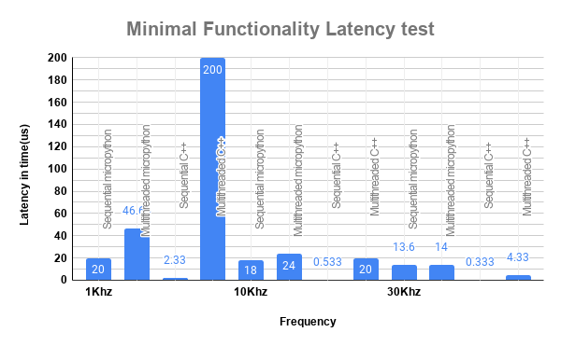
Result & Analysis for Minimal Functionality latency testing
When there is minimal functionality sequential C++ out performs every other language techniques. Multithreaded C++ shows a huge spike in the latency since there is very minimal load and it is trying to get into the FreeRTOS and fetch the data. Since, there is very minimal instructions sequential C++ is able to achieve it.

Slide 23
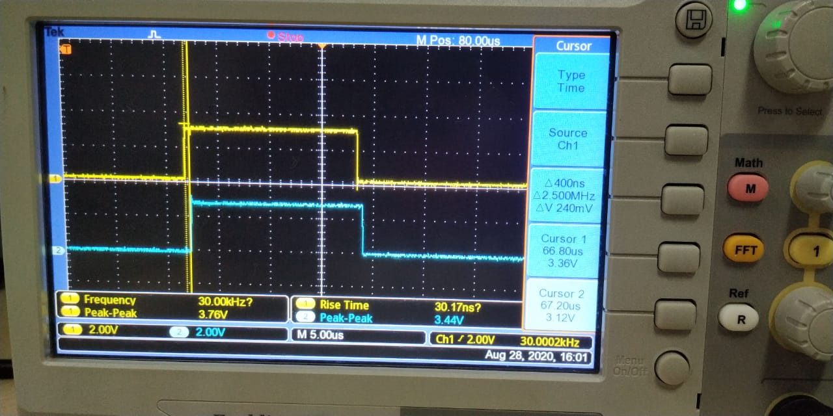
Output Screenshot of Minimal functionality latency testing
400 ns was the best latency under minimal functionality at 30 Khz for sequential C++.

Slide 24
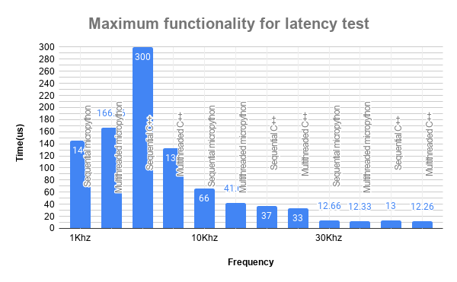
Result & Analysis for Maximum Functionality latency testing
In maximum functionality condition is when the whole program is dumped to the controller. The readings were concluded by taking 45 different samples and averaging the value. Multithreaded C++ proves to be having less latency when compare to other techniques.

Slide 25
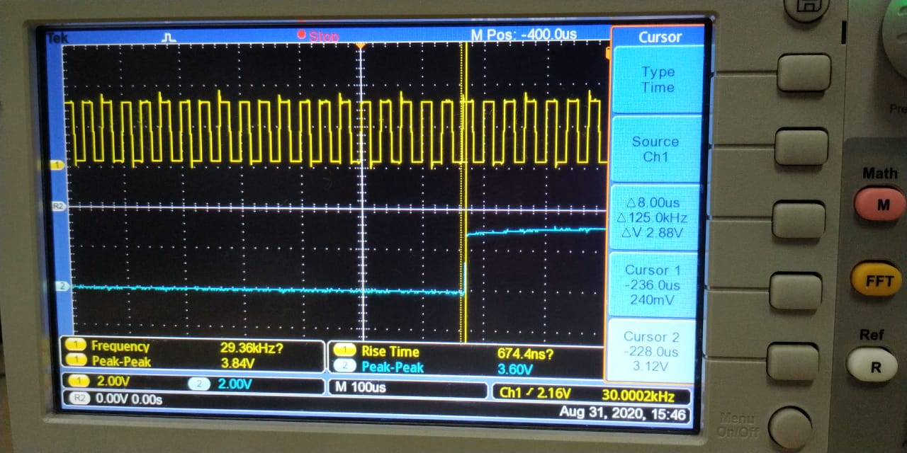
Output Screenshot of Maximum functionality latency testing
8us was the best latency under maximum functionality at 30 Khz for multithreaded C++.

Slide 26
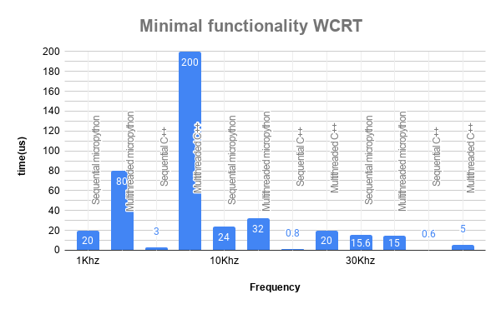
Result & Analysis for Minimal Functionality WCRT
The test is done under minimal load and the sequential C++ has very less WCRT. In minimal functionality always sequential C++ performs well. But in 5 Hz and 10 Hz multithreaded C++ and Micropython has more WCRT.

Slide 27
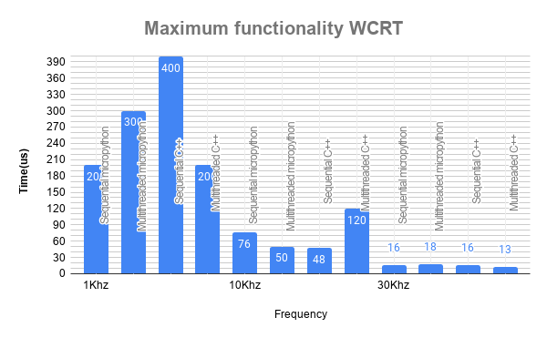
Result & Analysis for Maximum Functionality WCRT
During maximum loaded condition it is pretty evident that multithreaded C++ has the best WCRT and it outperforms other techniques. In maximum functionality always multithreaded C++ performs well.

Slide 28
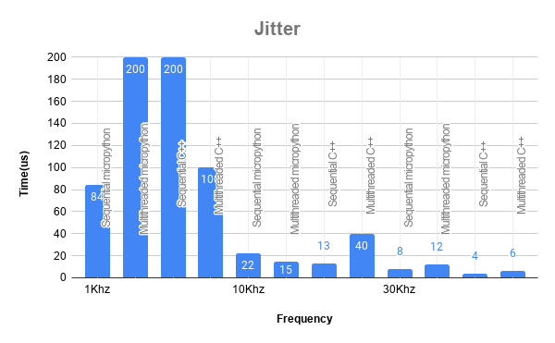
Jitter
Jitter is tested in maximum functionality scenario where the whole program is dumped to the controller. The Jitter value here is the difference between two consecutive latency readings and the greatest value is pointed out as jitter.

Slide 29
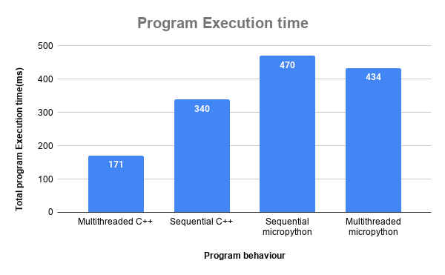
Total Execution time
Multithreaded C++ takes just 171ms to complete the cycle of execution whereas sequential Micropython takes around 470ms. Even though the latency for the Micropython is lesser than sequential C++ it takes more time to execute because Python is an interpreter and high level language whereas C++ is a compiler and low level language.

Slide 30
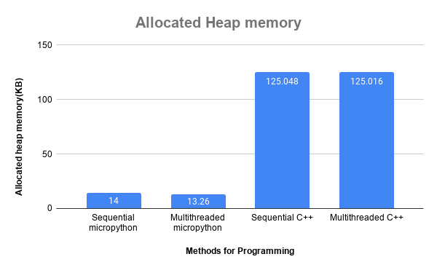
Result & Analysis on Allocated Heap memory
Micropython code is smaller, because lots of code which is needed is part of the micropython engine, while for C++ programs it is either part of your code or linked with your code. [This includes I/O and data handling.]

Slide 31
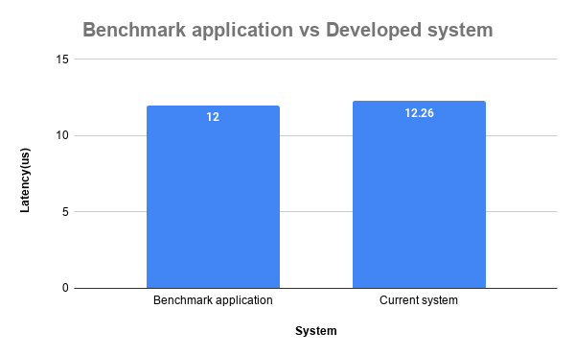
Benchmark application vs Developed application
The Benchmark Application was developed using Arduino controller and FreeRTOS coding. The components used were smoke, flame sensor, exhaust fan, alarming unit (LED and Buzzer). The lowest latency achieved was 12us. But, the developed system includes Water opening (Submersible water pump), Manual press button and water level sensor to monitor the tank level in addition to the Benchmark application. The latency for the maximum functionality is about 12.26us and multithreaded C++ achieves it with ease. The multithreaded Micropython wasn’t able to compete with multithreaded C++ and it’s still under development.

Slide 32
Conclusions and Outcomes
A Fire detection and Alarm system was designed and developed using different programming techniques.
It can be concluded from obtained result that, C++(multithreaded) perform well when compared with Micropython. This is because of 2 reasons
C++ is low level language whereas Python is high level language.
C++ is a compiler language whereas Micropython is interpreter language. So interpreter language always takes time to execute.
The Benchmark Application was developed using Arduino controller and FreeRTOS coding. The components used were smoke, flame sensor, exhaust fan, alarming unit (LED and Buzzer). The lowest latency achieved was 12us.
But, the developed system includes Water opening (Submersible water pump), Manual press button and water level sensor to monitor the tank level in addition to the Benchmark application. The latency for the maximum functionality is about 12.26us and multithreaded C++ achieves it with ease. The multithreaded Micropython wasn’t able to compete with multithreaded C++ and it’s still under development.

Slide 33
Suggestion for future work
It is important aspect to consider the future expansion of any developed work and to concentrate on future scope of the implemented work. Some future extensions can be considered for the Performance Analysis of a concurrent Fire detection and Alarming system as,
The hard real- time application can be developed using different languages like Lua, Java, Java script, Go, Ada etc and performance analysis can be done.
The system can be tested for Synchronization complexity, Robustness, Dynamic memory allotion, memory leaks, Dependability which can added up for comparison of performance analysis.

Slide 34
References
Higuera, T. (2012). About 15 years of Real-Time Java. Madrid 28040, Spain: Universidad Complutense de Madrid.
Ray, B., Posnett, D., Devanbu, P. and Filkov, V. (2017). A large-scale study of programming languages and code quality in GitHub. Communications of the ACM, 60(10), pp.91-100.
Zain, F., Tobias, M., Olaf, G., Andreas, L. (2019). Event-Driven Multithreading Execution Platform for Real-Time On-Board Software Systems.
Oyenike, B. (2012). COMPARATIVE ANALYSIS OF SOME PROGRAMMING LANGUAGES. Transnational Journal of Science and Technology, [online] 2(5), pp.107-118.
Sreeram, V., Surya, M., Akash, G., Niranjan, R., Sree, B., Shruthi, B. and Mohamed, S. (2018). Realtime Applications with RTMaps and Bluebox 2.0. International Conference of Artificial Intelligence 2018.

Slide 35
References
Nanz, S., Torshizi, F., Pedroni, m. and Meyer, B. (2013). Design of an empirical study for comparing the usability of concurrent programming languages. Information and SoftwareTechnology, 55, pp.1304-1315.
Nanz, S. and Faria, C. (2015). A Comparative Study of Programming Languages in Rosetta Code. 2015 IEEE/ACM 37th IEEE International Conference on Software, [online] pp.778-788.
Sheikh, A., Ghazala, I., Noman, K. (2016). A qualitative study of major programming languages. International Journal of Information and Communication Technology.
Silvia, D. (2015). The role of concurrency in an evolutionary view of programming abstractions. arXiv:1507.07719v1 [cs.PL] 28 Jul 2015
de Oliveira Turci, Luca. (2017). Real-Time Operating System FreeRTOS Application for Fire Alarm Project in Reduced Scale. International Journal of Computing and Digital Systemss. 6. 198-204. 10.12785/IJCDS/060405.

Slide 36
References
Mahmoud, A., Rabbah, N., Rabbah, H., Mounir, R. (2018). Python in Real Time Application for Mobile Robot . Smart Application and Data Analysis for Smart Cities (SADASC'18).
David, A., Christophe, D., Valerie, P., Fatiha, B., Maxime, B., Luc, Legres., Anne, J., Philippe, B. and Jean, Y. (2014). Automatic Image Quality Assessment in Digital Pathology: From Idea to Implementation. Sorbonne Paris Cité, 75205 Paris Cedex 13, France
Kulkarni, S., Prasanna, T., and Bramaramba, K. (2019). An IoT based Fire Detection, Precaution & Monitoring System using Raspberry Pi3 & GSM. INTERNATIONAL JOURNAL OF ENGINEERING RESEARCH & TECHNOLOGY (IJERT) Volume 08, Issue 07 (July 2019)

Slide 37
Acknowledgement
I intend to convey my sincere thanks to my project supervisor Professor. Jishmi Jos Choondal, Asst. Professor, Computer Science and Engineering Department for suggesting the dissertation topic and mentoring me thoughout the project work.

Slide 38
Thank You

